Slide 1

Design And Development Of An Online Food Selling Platform
Adel Bedoui
Najla sadi
Najla wesleti
Mohamed kharrat
Mohamed lahbib louati
Hlel Abdelhedi & Ouni Heni
2016/2017

Slide 2
Plan
Introduction
Problem
Existing solutions
Proposed solution
Implementation
Conclusion and perspectives

Slide 3
Introduction
Introduction > Problem > Existing solutions > Proposed solution > Implementation > Conclusion and perspectives

Slide 4
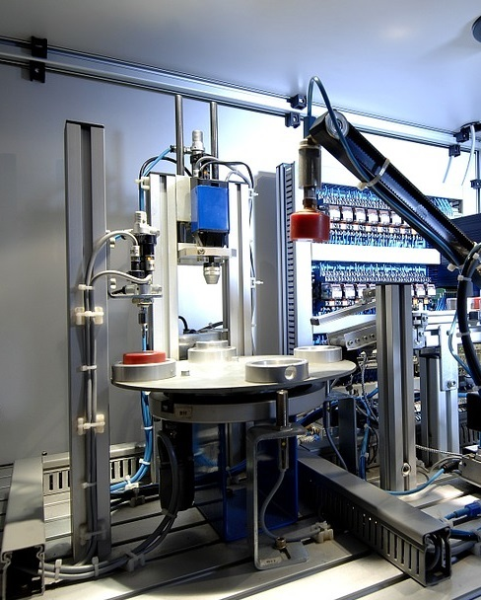
The digital revolution
The world has become very sophisticated.
Technology has become crucial to grow your business
Technology has invaded almost every industry
Introduction > Problem > Existing solutions > Proposed solution > Implementation > Conclusion and perspectives

Slide 5
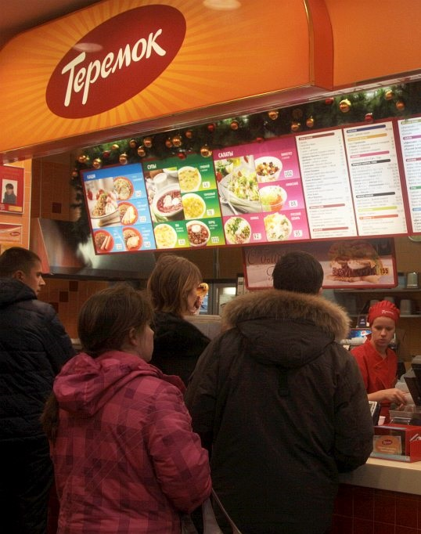
The sad truth
The technology haven’t conquered the food industry yet.
Even the existing solutions are not that sophisticated
Many problems are yet to solve.
Introduction > Problem > Existing solutions > Proposed solution > Implementation > Conclusion and perspectives

Slide 6

The company
EASYTEK is a young and ambitious Tunisian startup created in January 2016.
Introduction > Problem > Existing solutions > Proposed solution > Implementation > Conclusion and perspectives

Slide 7
2. Problem
Introduction > Problem > Existing solutions > Proposed solution > Implementation > Conclusion and perspectives

Slide 8
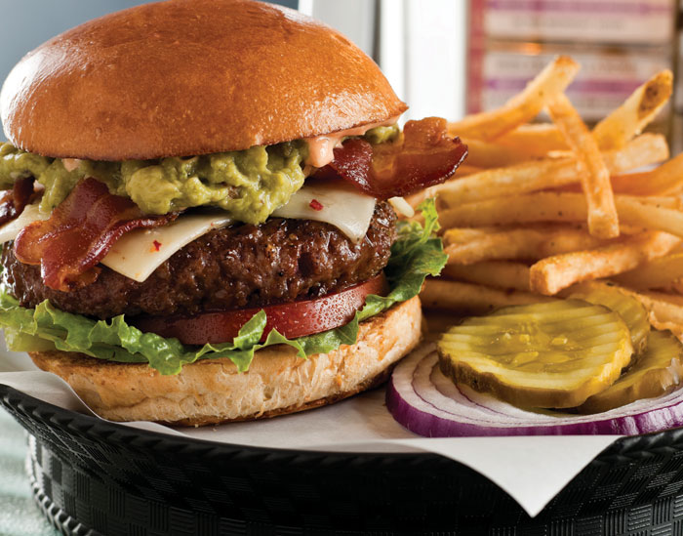
This is what you want?

Slide 9
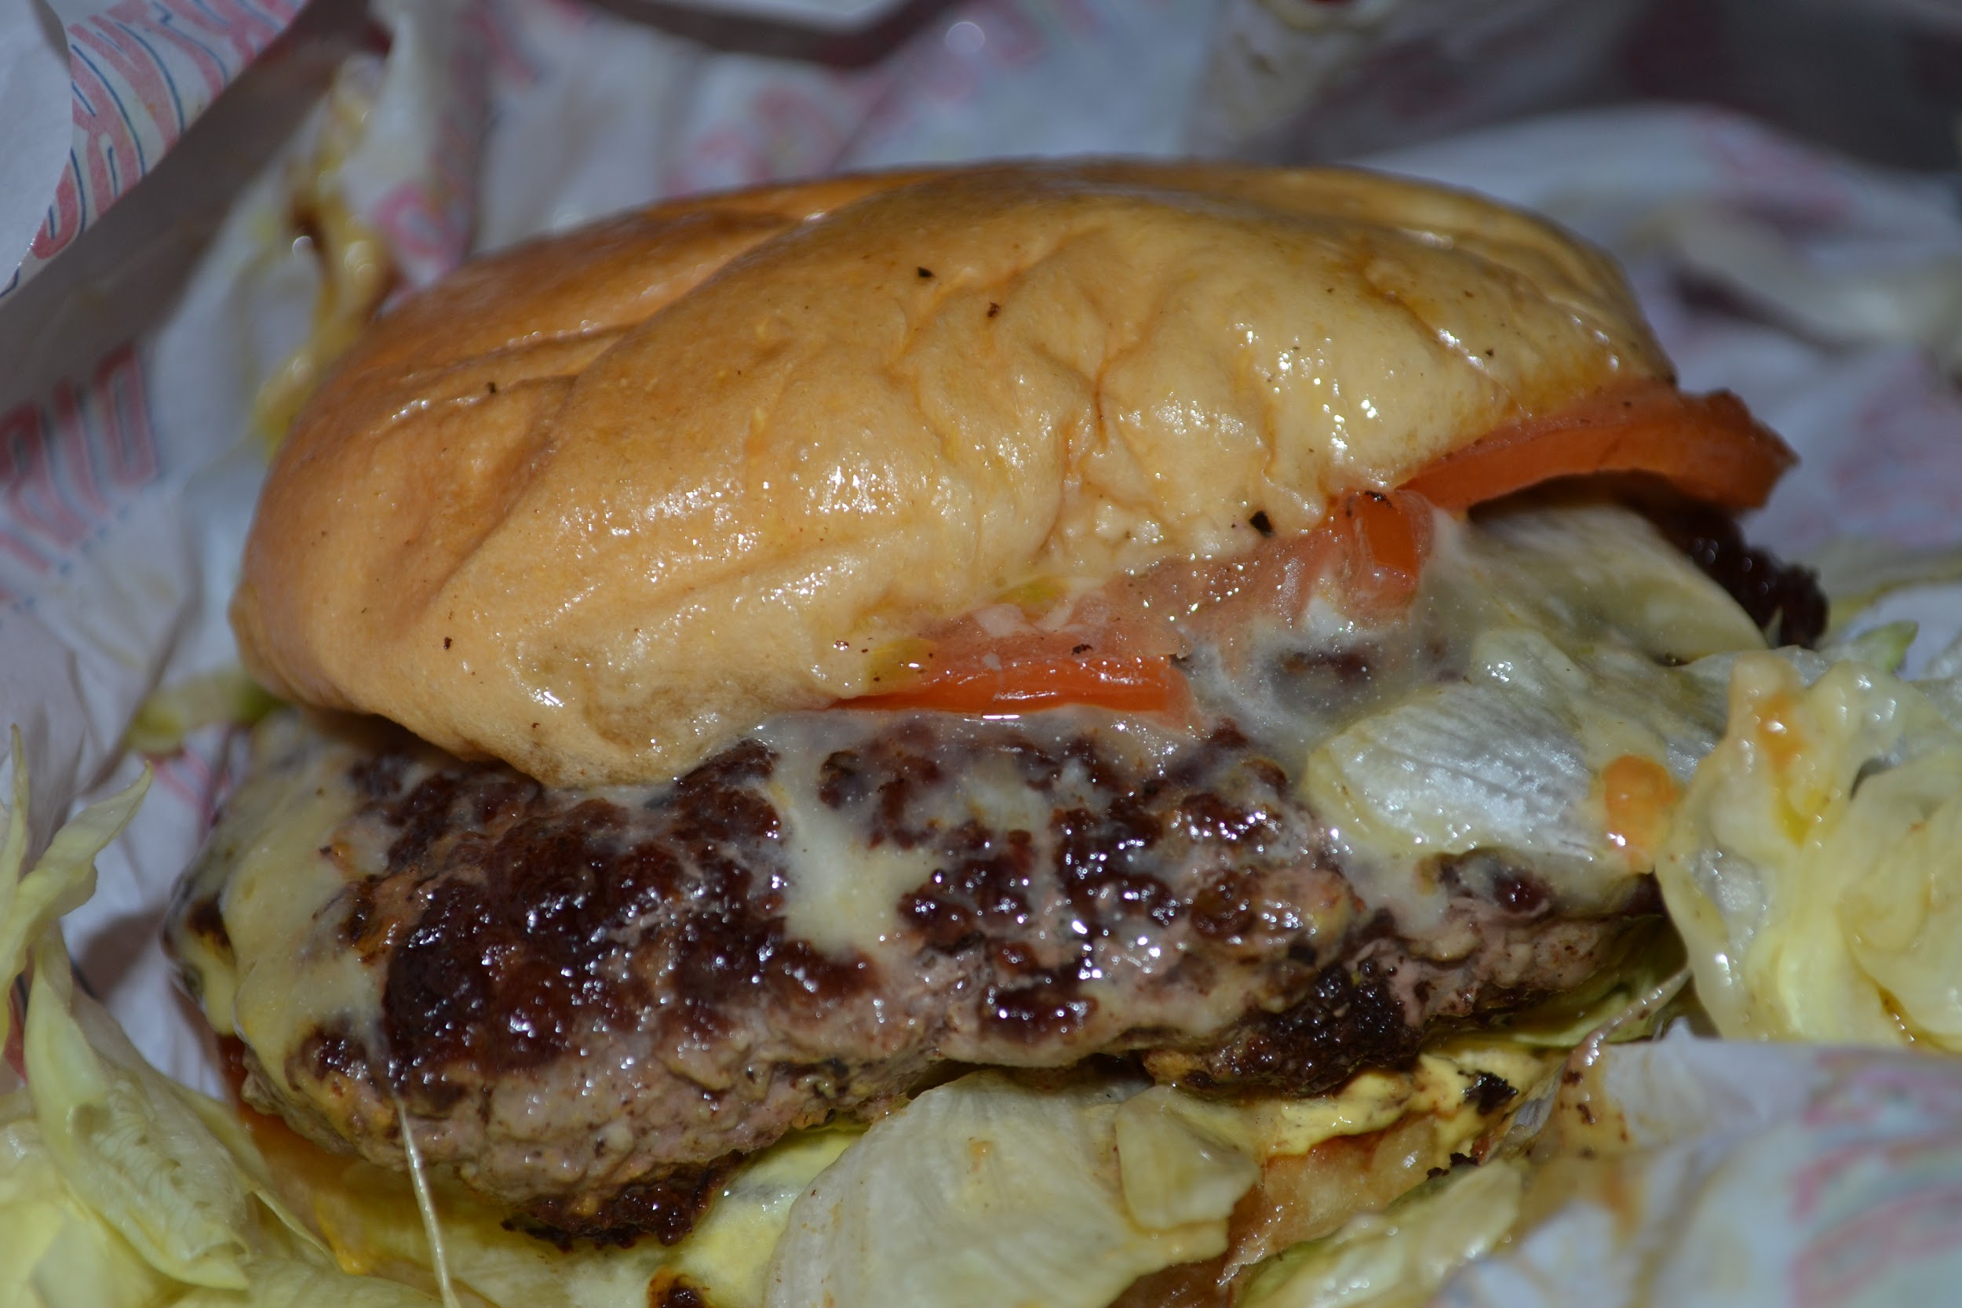
But this is what you get?
Notes:
hhhhhhhhhh

Slide 10
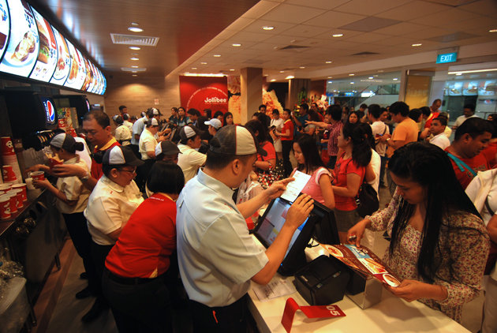
Don’t forget the long queues and the chaos
Notes:
hhhhhhhhhh

Slide 11

Vendors / Merchants are also threatened
Notes:
hhhhhhhhhh

Slide 12

Money is lost when customers are not satisfied.
Notes:
hhhhhhhhhh

Slide 13

The absence of an efficient tool to promote and communicate
Notes:
hhhhhhhhhh

Slide 14
3.
Existing Solution
Introduction > Problem > Existing solutions > Proposed solution > Implementation > Conclusion and perspectives

Slide 15


Existing Solution
These solution does not solve the various problems mentioned earlier.
They are based on just food delivery.
Introduction > Problem > Existing solutions > Proposed solution > Implementation > Conclusion and perspectives

Slide 16

Foody is the solution
Notes:
hhhhhhhhhh

Slide 17
4.
Proposed Solution
Introduction > Problem > Existing solutions > Proposed solution > Implementation > Conclusion and perspectives

Slide 18
4.
Proposed Solution
Requirements
Introduction > Problem > Existing solutions > Proposed solution > Implementation > Conclusion and perspectives

Slide 19

Customer Requirements
Ordering and payment
Transparency
Booking
Delivery
Introduction > Problem > Existing solutions > Proposed solution > Implementation > Conclusion and perspectives

Slide 20
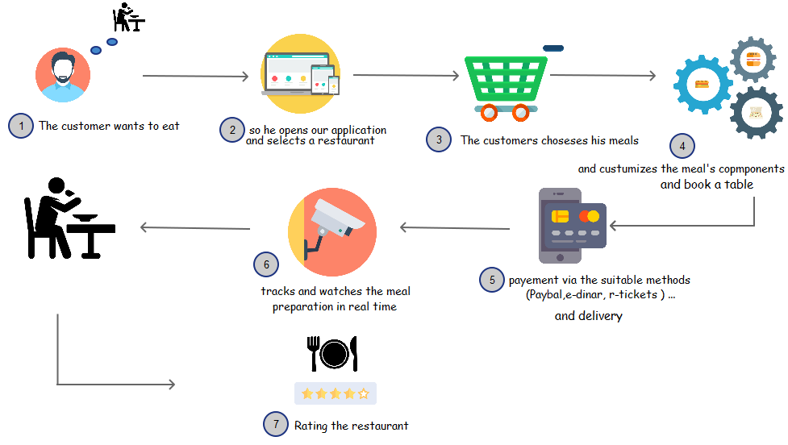
Proposed solutions for the customer
Introduction > Problem > Existing solutions > Proposed solution > Implementation > Conclusion and perspectives

Slide 21

Merchant Requirements
Restaurant and queue management
Marketing
Customer relationship management and business analytics
Introduction > Problem > Existing solutions > Proposed solution > Implementation > Conclusion and perspectives

Slide 22
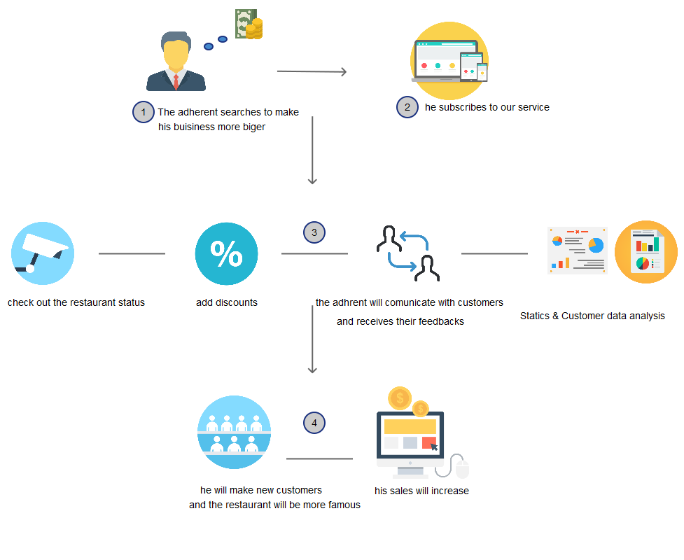
Proposed solutions for the merchant
Introduction > Problem > Existing solutions > Proposed solution > Implementation > Conclusion and perspectives
Notes:
Selon les besoin this the proposed solutions

Slide 23
4.
Proposed Solution
Design
Introduction > Problem > Existing solutions > Proposed solution > Implementation > Conclusion and perspectives

Slide 24




Global use case
Merchant / restaurant owner
Customer
Chef
Platform administrator
Introduction > Problem > Existing solutions > Proposed solution > Implementation > Conclusion and perspectives

Slide 25
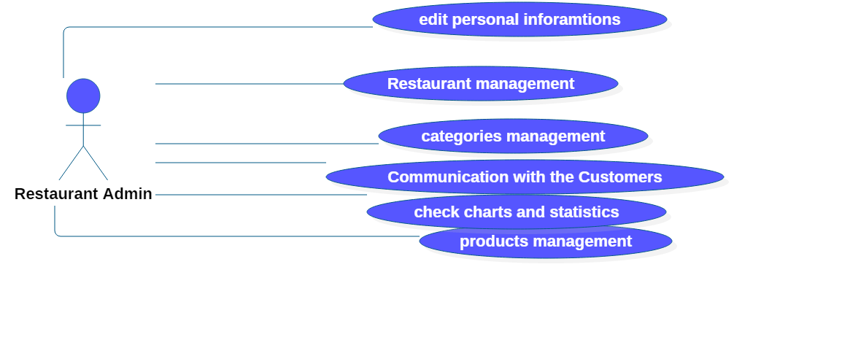
Global use case : Restaurant owner
Introduction > Problem > Existing solutions > Proposed solution > Implementation > Conclusion and perspectives

Slide 26
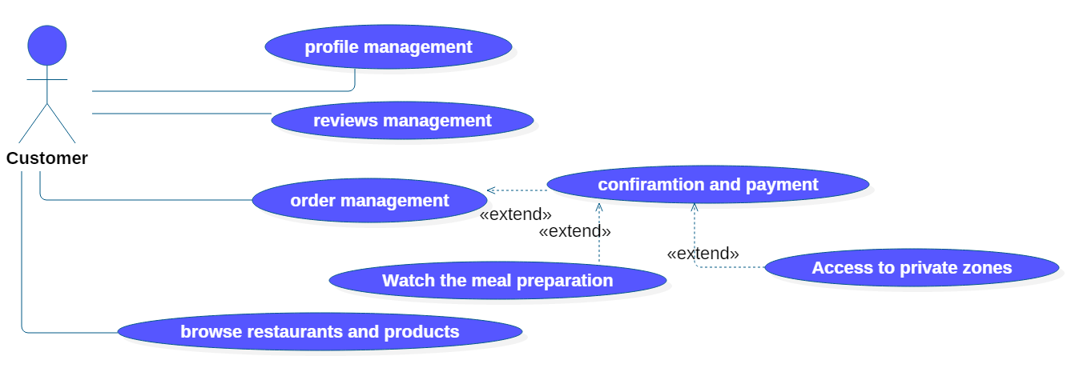
Global use case : Customer
Introduction > Problem > Existing solutions > Proposed solution > Implementation > Conclusion and perspectives

Slide 27
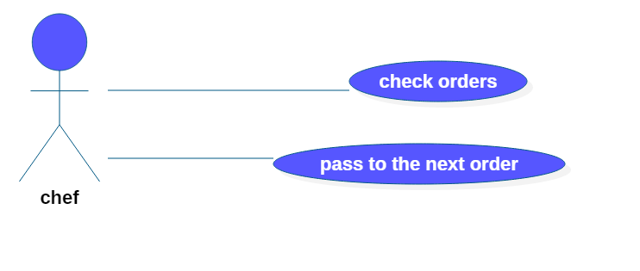
Global use case : The Chef
Introduction > Problem > Existing solutions > Proposed solution > Implementation > Conclusion and perspectives

Slide 28
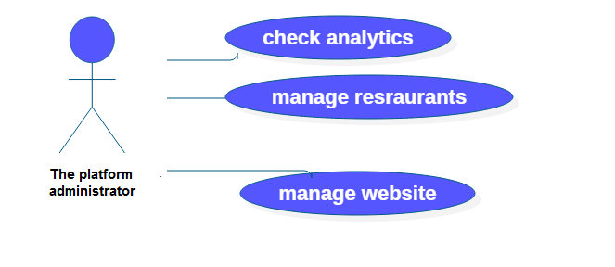
Global use case : The platform administrator
Introduction > Problem > Existing solutions > Proposed solution > Implementation > Conclusion and perspectives

Slide 29
UI Design
Material design
is a design language developed by Google That concentrates on grid-based layouts, responsive animations and transitions, padding, and depth effects such as lighting and shadows.
UX design
is how a person feels when interacting with a digital product.
Three principles
Accessibility
    Engagement
    Simplicity
UI design
User interface design (UI) is the design of user interfaces for a software

Slide 30
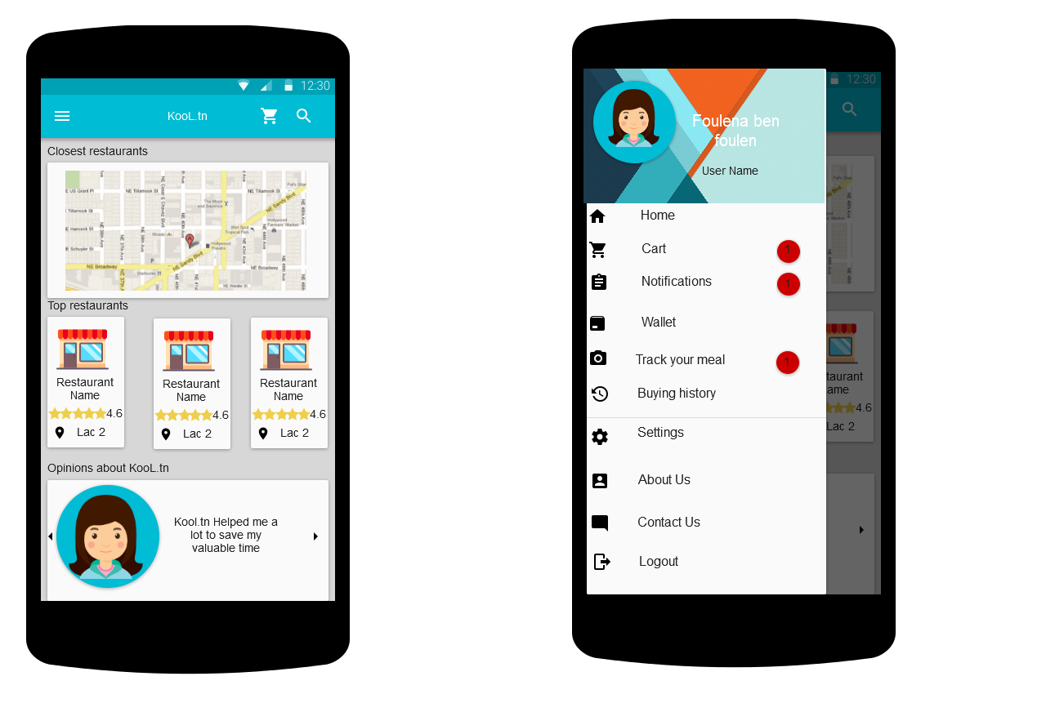
UI design
Simplicity
Accessibility
Engagement
Introduction > Problem > Existing solutions > Proposed solution > Implementation > Conclusion and perspectives

Slide 31
5.
Implementation
Introduction > Problem > Existing solutions > Proposed solution > Implementation > Conclusion and perspectives

Slide 32






Technologies
Introduction > Problem > Existing solutions > Proposed solution > Implementation > Conclusion and perspectives

Slide 33




Technologies
Introduction > Problem > Existing solutions > Proposed solution > Implementation > Conclusion and perspectives

Slide 34
Demo
Introduction > Problem > Existing solutions > Proposed solution > Implementation > Conclusion and perspectives

Slide 35
5.
Conclusion and Perspectives
Introduction > Problem > Existing solutions > Proposed solution > Implementation > Conclusion and perspectives

Slide 36
Conclusion
The road to accomplishments (3D process)
The opportunity
Introduction > Problem > Existing solutions > Proposed solution > Implementation > Conclusion and perspectives

Slide 37
Perspectives
The unfinished features:
Real time meal preparation watching
Cart (Product) customization
Android and IOS application development
Introduction > Problem > Existing solutions > Proposed solution > Implementation > Conclusion and perspectives

Slide 38
THANKS!
Any questions?

